Slide 1
CSCE 823 In Class Day 07
ANN Training: Regularization
Live Synchronous session

Slide 2
Agenda
Regularization Review (Part 2)
Student Lecture Topic Proposal / Q&A
Project Discussion / Q&A
Break (if needed)
General Q&A

Slide 3
Types of regularization
Weight Decay (Penalize parameters) (7.1-7.3)
Dataset augmentation (7.4)
Adding noise to weights or targets (7.5)
Semi-Supervised Learning (7.6)
Multi-Task Learning (7.7)
Early Stopping (7.8)
Parameter Tying and Parameter Sharing (7.9)
Sparse Representations (7.10)
Adversarial Training (7.13)
Bagging (7.11) & Dropout (7.12)
Tangent Distance/Prop and Manifold Tangent Classifier (7.14)

Slide 4
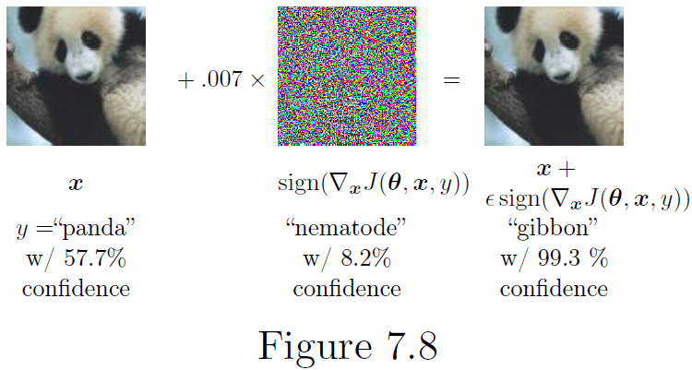
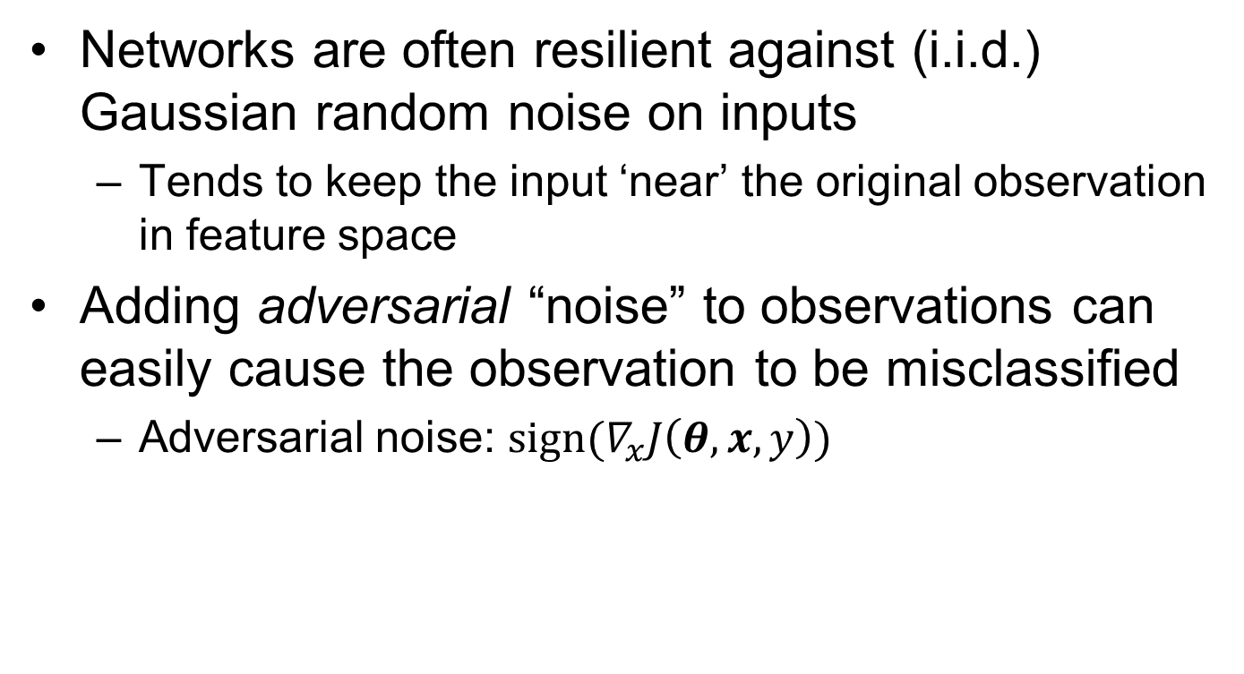
Adversarial Training Intuition
Networks are often resilient against (i.i.d.) Gaussian random noise on inputs
Tends to keep the input ‘near’ the original observation in feature space
Adding adversarial “noise” to observations can easily cause the observation to be misclassified
Adversarial noise: $sign(∇_{x}J\left(θ,x,y\right))$

Slide 5

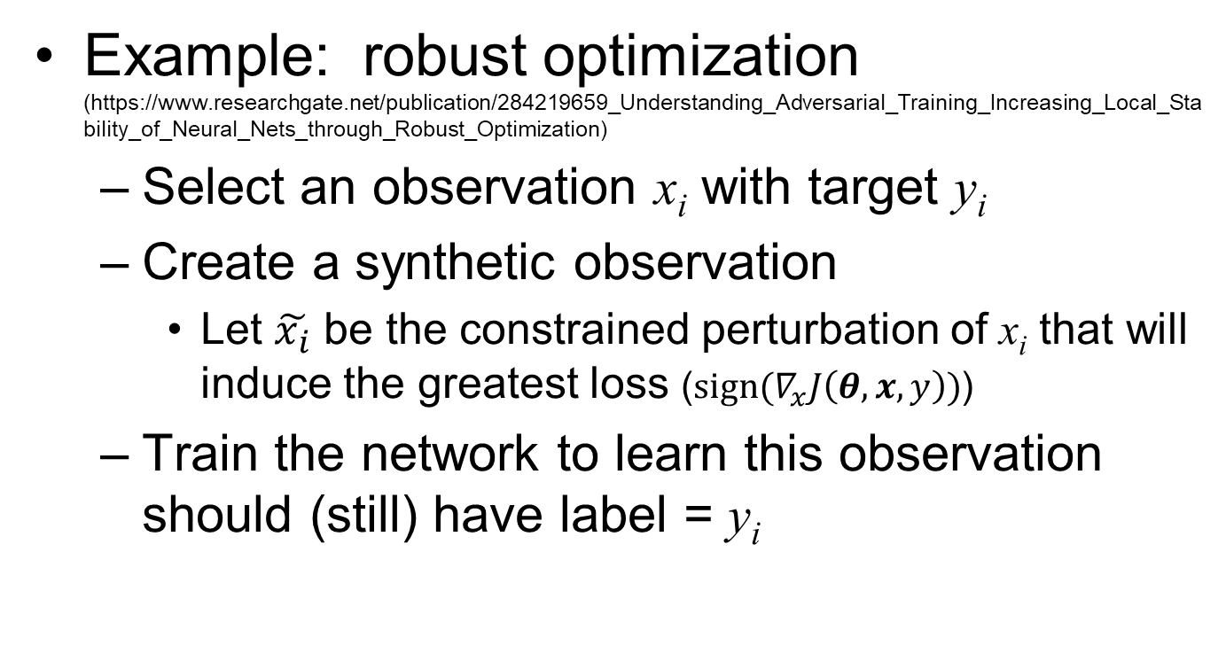
Adversarial Training Concept
Example: robust optimization (https://www.researchgate.net/publication/284219659_Understanding_Adversarial_Training_Increasing_Local_Stability_of_Neural_Nets_through_Robust_Optimization)
Select an observation x_{i} with target y_{i}
Create a synthetic observation
Let $\tilde{x_{i}}$ be the constrained perturbation of x_{i} that will induce the greatest loss ($sign(∇_{x}J\left(θ,x,y\right))$)
Train the network to learn this observation should (still) have label = y_{i}
What are we actually doing to $\tilde{x_{i}}$ when we do this?

Slide 6
Adversarial Training Concept
Example: robust optimization (https://www.researchgate.net/publication/284219659_Understanding_Adversarial_Training_Increasing_Local_Stability_of_Neural_Nets_through_Robust_Optimization)
Select an observation x_{i} with target y_{i}
Create a synthetic observation
Let $\tilde{x_{i}}$ be the constrained perturbation of x_{i} that will induce the greatest loss ($sign(∇_{x}J\left(θ,x,y\right))$)
Train the network to learn this observation should (still) have label = y_{i}
Move $\tilde{x_{i}}$ in the direction that makes it look less like the current class

Slide 7

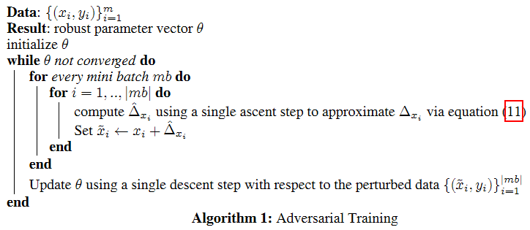
Adversarial Training Algorithm https://www.researchgate.net/publication/284219659_Understanding_Adversarial_Training_Increasing_Local_Stability_of_Neural_Nets_through_Robust_Optimization
Approximate the perturbed example using first-order Taylor series expansion
Execute Adversarial Training Algorithm:

Slide 8
Dropout: Intuition
A set of different (partially connected) networks trained using the same data should have different convergence properties
Different gradients and local minima
Less chance of all models overfitting
Ensemble of the set should outperform any individual network
We can simulate the concept on a single network by manipulating the training process

Slide 9
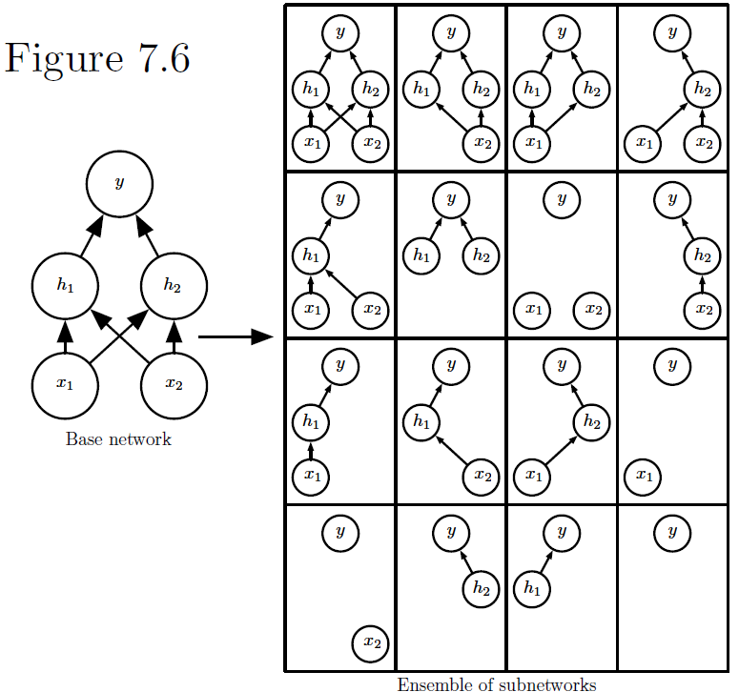
Dropout: Visual Interpretation
Simulate training different networks by temporarily eliminating weights at different stages of training (Include hidden nodes & inputs too)

Slide 10
Dropout Overview
During training, for each training batch in turn, select a random set of nodes/inputs to drop
Select via probability parameter
Output of each dropped node/input → zero
Multiply remaining nodes’ outputs by a per-layer scaling factor to ‘make up’ for the lost value from dropped nodes
Keep updating weights via backprop → simulates shared weight learning across models

Slide 11
Basic Tips for Dropout (in fully-connected layers)
Use dropout value of 20%-50% of neurons (20% is a good starting point)
too low → minimal effect ; too high → under-learning
Use a larger network to simulate more possible subnets/independent representations & compensate for smaller effective capacity.
Use dropout on both input (~0.2) and hidden units (~0.5).
Use a large learning rate with decay and a large momentum.
Increase your learning rate by a factor of 10 to 100
Use a high momentum value of 0.9 or 0.99
Constrain the size of network weights. A large learning rate can result in very large network weights. Imposing a constraint on the size of network weights such as max-norm regularization with a size of 4 or 5 has been shown to improve results.
model.add(Dense(60, input_dim=60,
kernel_initializer='normal',
activation='relu', kernel_constraint=maxnorm(3)))
From: http://machinelearningmastery.com/dropout-regularization-deep-learning-models-keras/

Slide 12
Student Lecture Topic Discussion
Proposal due 17 July
What questions do you have?

Slide 13
Project Discussion
Proposal due 24 July
What questions do you have?

Slide 14
Break

Slide 15
General Q&A

Slide 16
Backup Slides

Slide 17
How is regularization broadly defined?
Definition: “Regularization is any modification we make to a learning algorithm that is intended to reduce its generalization error but not its training error.” (Sec 5.2.2 - Goodfellow 2016, emphasis added)
Regularization been used to describe any modification to the entire learning process to help generalization, including changes to the algorithm AND the data

Slide 18
Bagging / Ensemble Intuition
Different training yields Different models
Key idea – a set of different models is unlikely to make all the same errors on the test set
Worst case if all models same – no improvement
Best case if all models different - expected squared error of ensemble decreases linearly with the ensemble size.

Slide 19
Bagging / Ensemble Techniques
Ensemble of different kinds of models
Different training algorithms
Different objective functions
Bagging: Train on different data subsets
Boosting: incrementally train to correct error
Incrementally add more ANNs to ensemble
Add more nodes to an ANN
Problem… training many different ANNs with different subsets of data is expensive…

Slide 20
From Ensembles to Dropout Intuition
A set of different (partially connected) networks trained using the same data should have different convergence properties
Different gradients and local minima
Less chance of all models overfitting
We can simulate the concept on a single network by manipulating the training process

Slide 21
Dropout implementation (1/2)
import numpy as np
epochs = 1
X = np.array([ [0,0,1],[0,1,1],[1,0,1],[1,1,1] ])
y = np.array([[0,1,1,0]]).T
alpha,hidden_dim,dropout_percent,do_dropout = (0.5,4,0.2,True)
synapse_0 = 2*np.random.random((3,hidden_dim)) - 1
synapse_1 = 2*np.random.random((hidden_dim,1)) - 1
for j in range(epochs):
layer_1 = (1/(1+np.exp(-(np.dot(X,synapse_0)))))
if(do_dropout):
layer_1_ones = [np.ones((len(X),hidden_dim))]
layer_1_DropMask = np.random.binomial(layer_1_ones,1-dropout_percent)[0]
layer_1_multMask = layer_1_DropMask * (1.0/(1-dropout_percent))
layer_1 *= layer_1_multMask
layer_2 = 1/(1+np.exp(-(np.dot(layer_1,synapse_1))))
layer_2_delta = (layer_2 - y)*(layer_2*(1-layer_2))
layer_1_delta = layer_2_delta.dot(synapse_1.T) * (layer_1 * (1-layer_1))
synapse_1 -= (alpha * layer_1.T.dot(layer_2_delta))
synapse_0 -= (alpha * X.T.dot(layer_1_delta))
DROPOUT
Initialize Weights
Training Loop
Compute Activation Hidden
DROPOUT
Compute Activation out
Backprop
Compute Deltas
Update weights
Inspired by: http://iamtrask.github.io/2015/07/28/dropout/

Slide 22
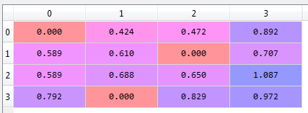
Dropout implementation (2/2)
[array([[ 1., 1., 1., 1.],
[ 1., 1., 1., 1.],
[ 1., 1., 1., 1.],
[ 1., 1., 1., 1.]])]
layer_1_ones = [np.ones((len(X),hidden_dim))]
layer_1_DropMask = np.random.binomial(layer_1_ones,
1-dropout_percent)[0]
layer_1_multMask = layer_1_DropMask * (1.0/(1-dropout_percent))
layer_1 *= layer_1_multMask
[[0 1 1 1]
[1 1 0 1]
[1 1 1 1]
[1 0 1 1]]
[[ 0. 1.25 1.25 1.25]
[ 1.25 1.25 0. 1.25]
[ 1.25 1.25 1.25 1.25]
[ 1.25 0. 1.25 1.25]]

